Slide 1
METRO TICKET RESERVATION SYSTEM
Team no:B5
035-JOGA ROSHINI
005-KOMMU ASHA

Slide 2
Features of project
User :
Register
Reserve a ticket
Search for the train
Display the ticket
Changing reservation
Ticket cancelling
Admin:
Update train details
Show the status
Display the registered users

Slide 3
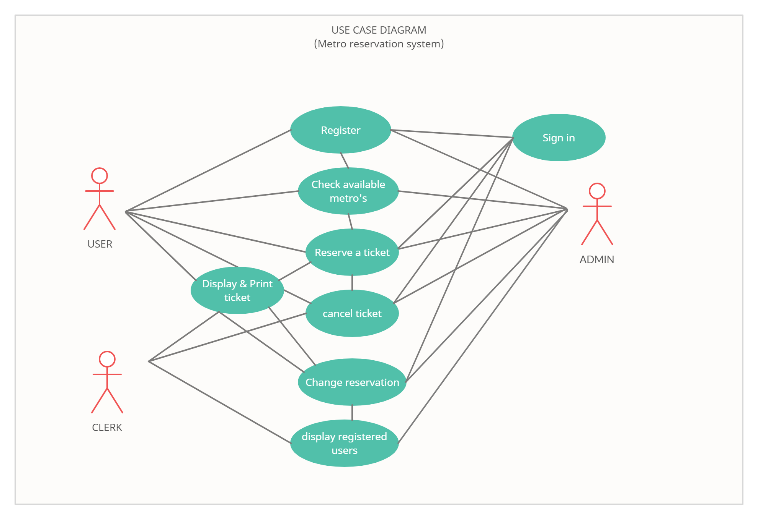

Slide 4
User case description
User case ID: UC01
name: Register
actors: User/ customer
Description: this allows the user to register if they did not and allows to login afterwards.
Pre-conditions: user needs to choose register option
Post-conditions: user can enter their desired details and successfully gets registered.
USER | SYSTEM
1. chooses to register .
 | 2.Asks the desired details
3.Enters the desired details
 | 4.Gets registered into the system.

Slide 5
User case description.
User case ID:UC02
Name: reservation of the ticket
Actors : user
Description: allows user to reserve ticket.
Pre-conditions: user need to enter their name and no. Of tickets required.
Post-conditions: user can successfully gets reserved for the ticket.
USER | SYSTEM
1. Chooses to reserve metro ticket
 | 2.Asks to enter name and no. Of tickets
3.Enters the data required.
 | 4. Prints the ticket and reserves your ticket

Slide 6
USER CASE DESCRIPTION
User case ID:UC03
Name: viewing all metro trains.
Actors:users
Description: allows user to view all metro trains.
Pre-Conditions: views all metro stations and asks to select train number
post-conditions: user enters the train number succesfully.
USER | SYSTEM
1.Choose to view all metro trains
 | 2.Asks to select the metro train number
3.Enters the selected metro train number
 | 4.Validates the train number. 4.1. if data is valid,shows all metro’s 4.2.if data is invalid. Display error message and prompts for new data.

Slide 7
User case description:
User case:UC04
Name: Displaying the ticket
Actors:users
Description: allows the user to login and display the ticket whenever they want.
Pre-conditions: user needs to select display ticket
Post-conditions: user logs in and displays the ticket
USER | SYSTEM
1. Choose to display the ticket
 | 2.Asks to Log in to the his/her account
3. Logs in to the account.
 | 4.Validates the details (i)If data is valid, displays the ticket. (ii)If data is invalid, asks to re-enter the data.

Slide 8
User case description
User case:uc05
Name: cancelling reservation.
Actors:users
Description:allows user to cancel reservation
Pre-Conditions: asks the user to enter the train number to cancel
Post-conditions: system succesfully cancel the reservation
user | system
1. Chooses to cancel reservation.
 | 2.Asks the metro train number to cancel
3.Enters train number
 | 4.Validates the information 4,1,if data is valid, cancels the reservation. 4.2.if data invalid, displays error message and prompts for new data.

Slide 9
User case description
User case ID:UC06
Name: displays the number of registered users.
Actors: admin
Description: allows user to display the registered users.
Pre-Conditions: none
Post-conditions: shows the registered users.
USER | SYSTEM
1.Chooses to display the number of registered users
 | 2.Shows the registered users who registered.

Slide 10
User case description
User:UC07
Name: changing the date of boarding.
Actors:users
Description: allows user to change the date of travelling
Pre-conditions: asks user to enter the date he/she wants to change to
Post-conditions:system successfully changes the date of boarding and prints the new ticket.
USER | SYSTEM
1.Chooses to change the date of reservation
 | 2.Asks to log-in and enter the date he/she wants to change to
3.Enters the data
 | 4.Validates the information and changes the date of reservation.

Slide 11
Main flow:
Train management
Passenger management
Seats management
Booking management
Change date management
Reservation
process
Station management

